Slide 1
Magic Ranch & Arizona Farms Annexation
Fiscal Cost/Benefit Summary
July 29th, 2013
Presented By:
Jim Rounds
Senior Economist, Elliott D. Pollack & Company
Notes:
1
1
1

Slide 2
Fiscal impact analysis captures:
Government revenues and expenses from all related activity attributed to annexation
Elliott D. Pollack & Company

Slide 3
Town of Florence Revenue Sources
GENERAL FUND OPERATING REVENUE
Sales tax
Sanitation Operating Tax
Property tax
Franchise Fees
APS
Phone
Gas
Cable
Utility
Sanitation
State Shared Sales Tax
State Shared Income Tax
Auto Lieu Tax (VLT)
DEVELOPMENT REVENUE
Construction Sales tax
Building Permit Fees
Community Development Fees
Development Impact Fees
Highway User Revenue Fund (HURF)
County Shared Transportation Excise Tax

Slide 4
Town of Florence Expenses
OPERATING EXPENSES
Special Census
Fire
Police
Parks and Recreation
Community Development
Public Works (Paid through HURF)
CAPITAL EXPENSES
Equipment
Vehicles
Road Repair & Maint.
Capital Projects
Streetlights
Traffic Control Devices
Drainage
Road Widening

Slide 5
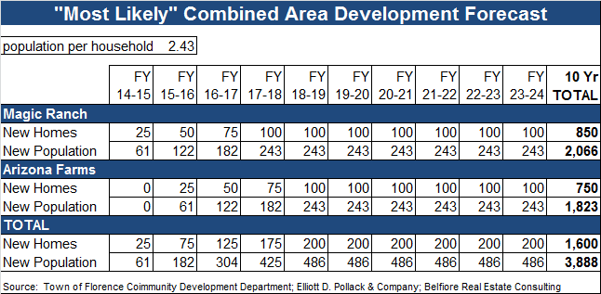
Contains Impacts of Expected Development

Slide 6
ANALYSIS
RESULTS
Elliott D. Pollack & Company

Slide 7
Operational Revenue and Expenses result in a net fund balance of $13.9 million over 10 years.
Capital Expenses to Revenue result in a net fund balance of $3.9 million after 10 years.
Infrastructure Improvement projects will be implemented through developer contributions and non-General Fund revenue when feasible.

Slide 8
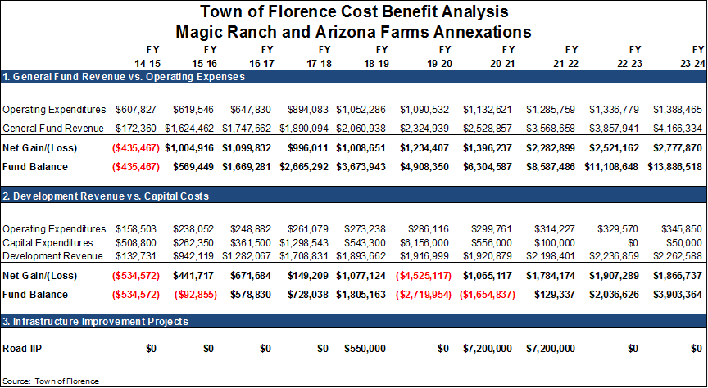

Slide 9
Final Points
Significant State/County Shared Revenue
Large volume of finished lots can have homes built as soon as market conditions improve.
Operational costs are incremental additions to an existing Town Government infrastructure.
New infrastructure projects will be jointly funded by the Town, developer contributions and impact fees. Financing solutions exist beyond Fund Balance.
Future commercial development along major corridors (Hunt Highway & Arizona Farms) will be captured by the Town.

Slide 10
ELLIOTT D. POLLACK
& Company
Economic and Fiscal Impact Analysis/Modeling
Real Estate Market and Feasibility Studies
Litigation Support
Revenue Forecasting
Keynote Speaking
Public Finance and Policy Development
Land Use Economics
Economic Development
7505 East Sixth Avenue, Suite 100 Scottsdale, Arizona 85251
480-423-9200 P / 480-423-5942 F / www.arizonaeconomy.com / info@edpco.com
Notes:
10
10
10

